Slide 1

Exploratory Data Analysis
G2M insight for Cab Investment firm
Date: 16/10/2022
Username: alassirifatima@gmail.com
LISUM14: 30Sep – 30 Dec 2022

Slide 2

Agenda
Executive Summary
Problem Statement
Approach
EDA
EDA Summary
Recommendations

Slide 3
Executive Summary
XYZ is a private equity firm in the US.
Due to remarkable growth in the Cab Industry in the last few years and multiple key players in the market, it is planning for an investment in the Cab industry.
Timeframe of the data: 2016-01-31 to 2018-12-31.
Total data points:355,032

Slide 4
Problem Statement
Objective:
Provide actionable insights to help XYZ firm in identifying the right company for making an investment.
Compare Yellow Cab firm and Pink Cab Firm.

Slide 5
Approach
Review the source Documentation.
Understanding data.
Identify relationships across files.
Cleaning and Preparing data.
Features Analysis.
Correlation.
Summary.

Slide 6
Data Exploration
Here are provided 4 individual data sets. The time period of data is from 31/01/2016 to 31/12/2018.
Cab_Data.csv – this file includes details of transactions for 2 cab companies.
Customer_ID.csv – this is a mapping table that contains a unique identifier that links the customer’s demographic details.
Transaction_ID.csv – this is a mapping table that contains transaction-to-customer mapping and payment mode.
City.csv – this file contains a list of US cities, their population, and the number of cab users.

Slide 7
Data Exploration (Con.)
The Goals:
Compare Yellow Cabs and Pink Cabs from Different Aspects:
Compare between Yellow Cab and pink Cab by performance.
Which Cab firm’s profit is increased?
Which Cab firm is favored by customers?
Which Cab firm in most cities?
Which Cab firm bigger market share?

Slide 8
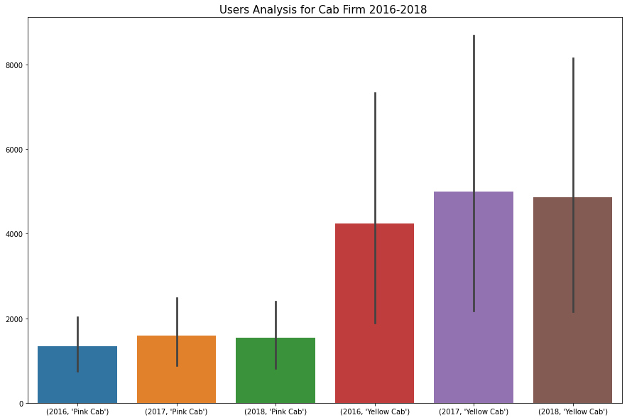
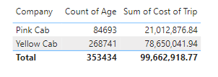
EDA - User Analysis for Cab Firm 2016 - 2018
This chart shows the number of users for Yellow Cab and Pink Cab through 3 years.
The Yellow Cab has higher Users than Pink Cab.

Slide 9
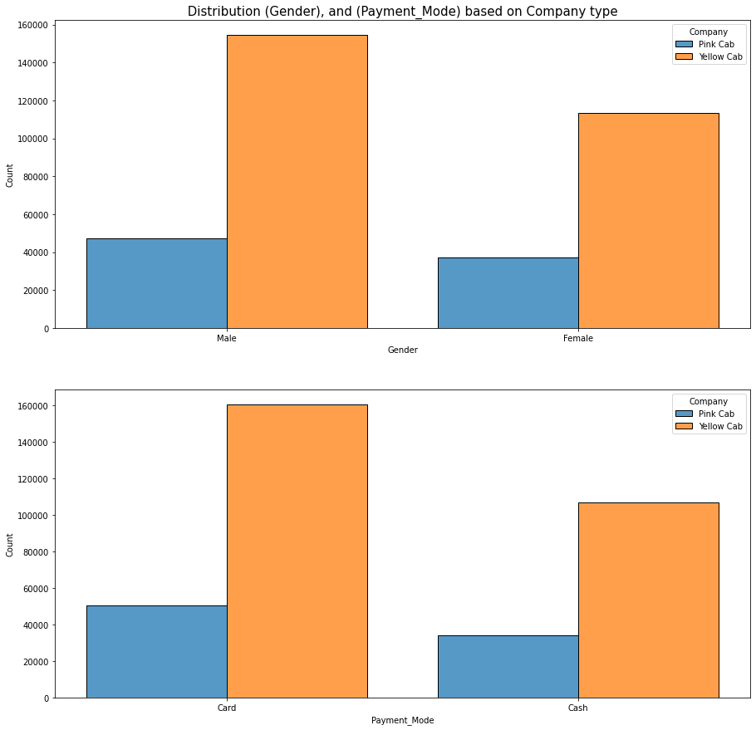
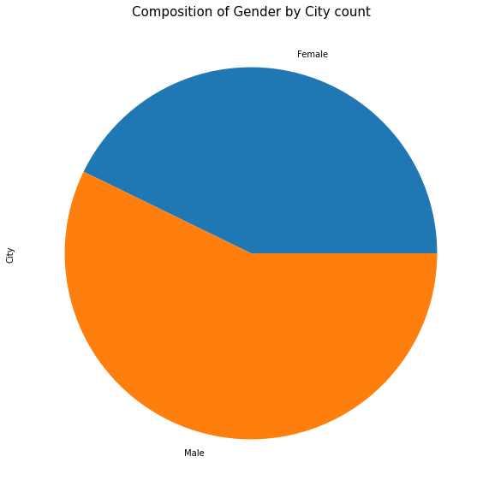
EDA - Gender Analysis 1

Slide 10
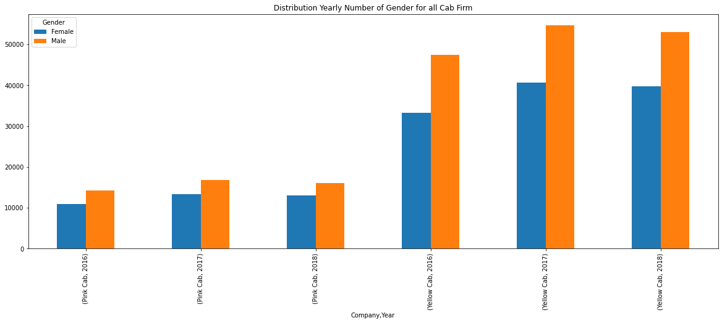
EDA - Gender Analysis 2
f
Th

Slide 11
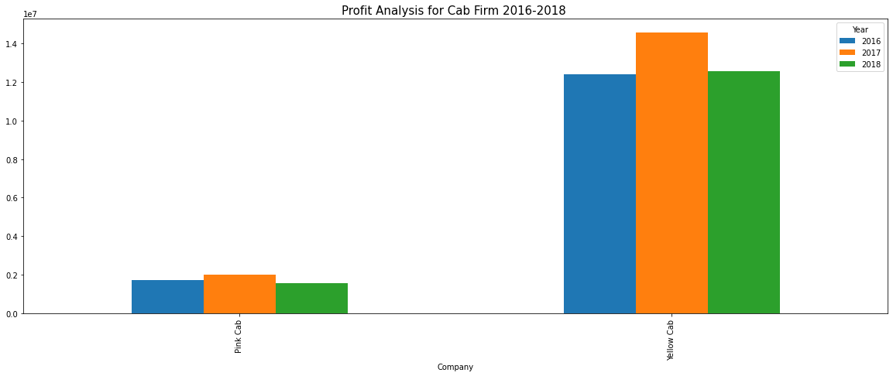
EDA - Profit Analysis 1
The Profit Analysis shows that Yellow Cab earned more profit through years

Slide 12
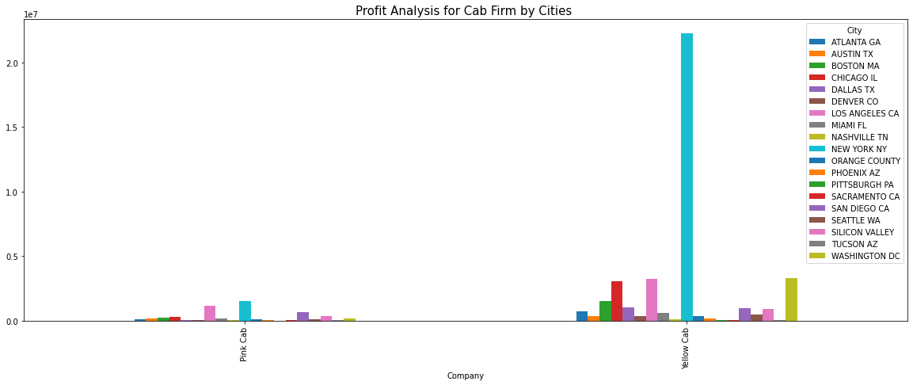
EDA - Profit Analysis 2
f
Th

Slide 13
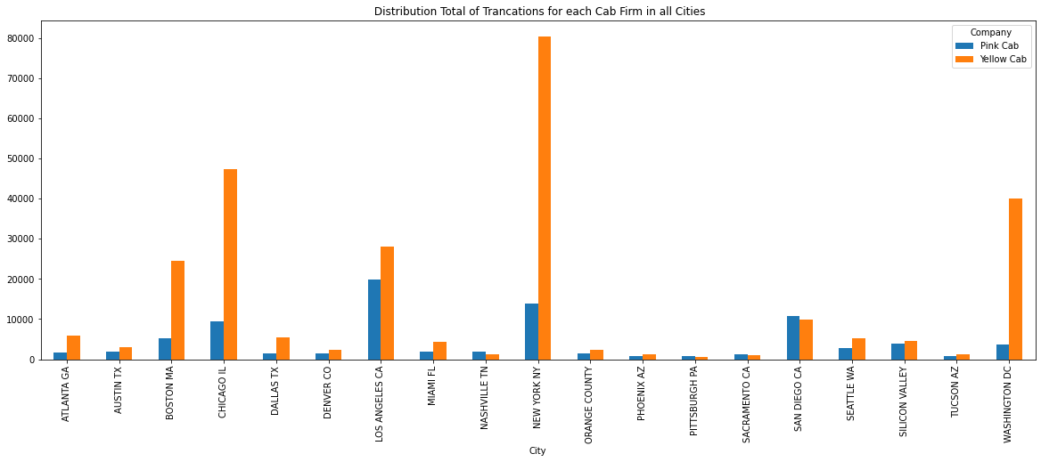
EDA - Transaction Analysis
f
Th

Slide 14
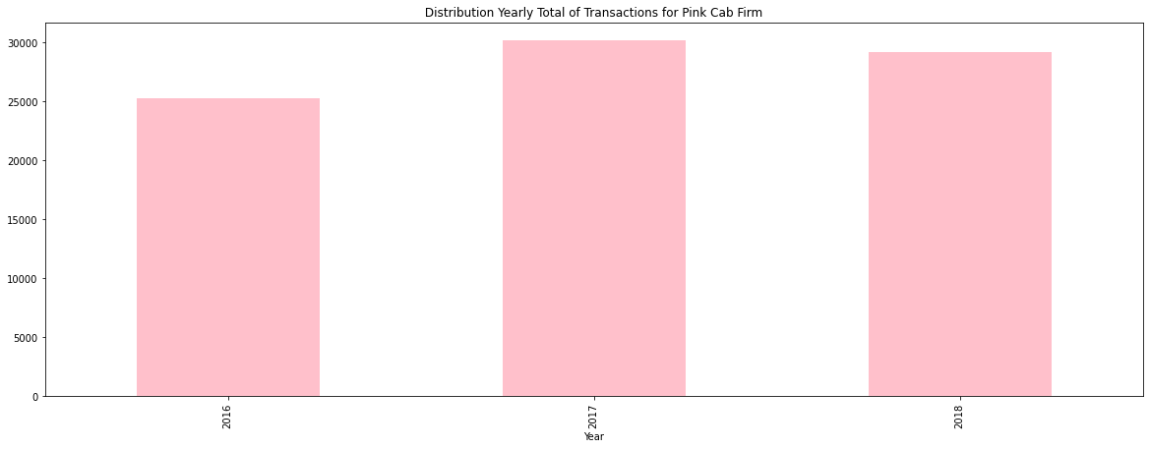
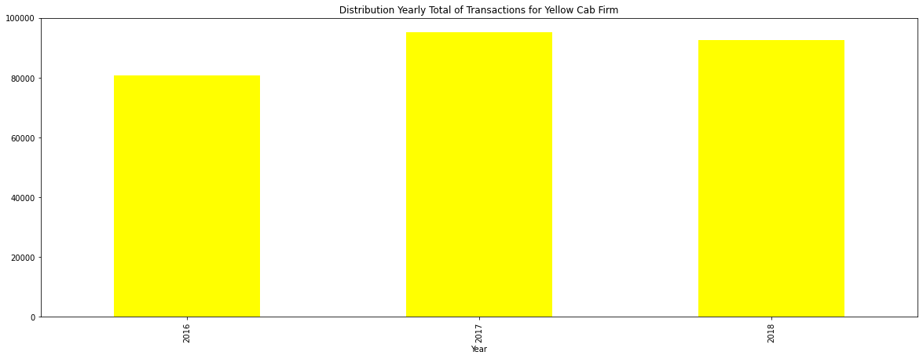
EDA - Yearly total of Transactions for each Cab

Slide 15
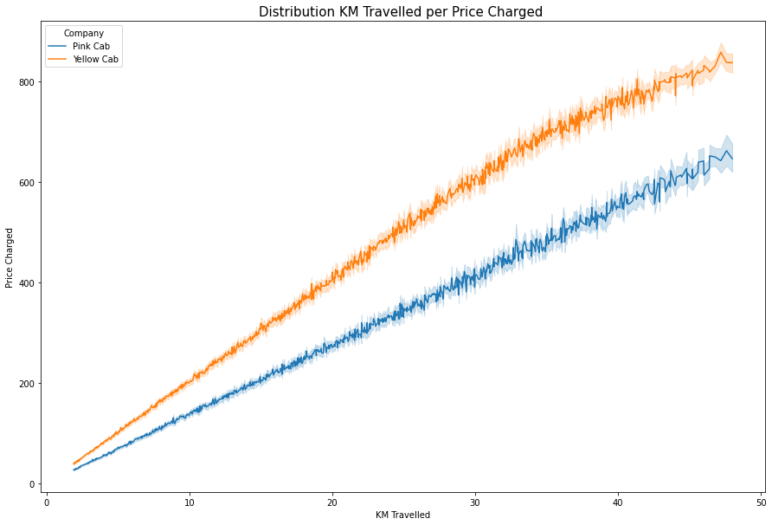
EDA - Distribution KM Travelled per Price Charged
f
Th

Slide 16
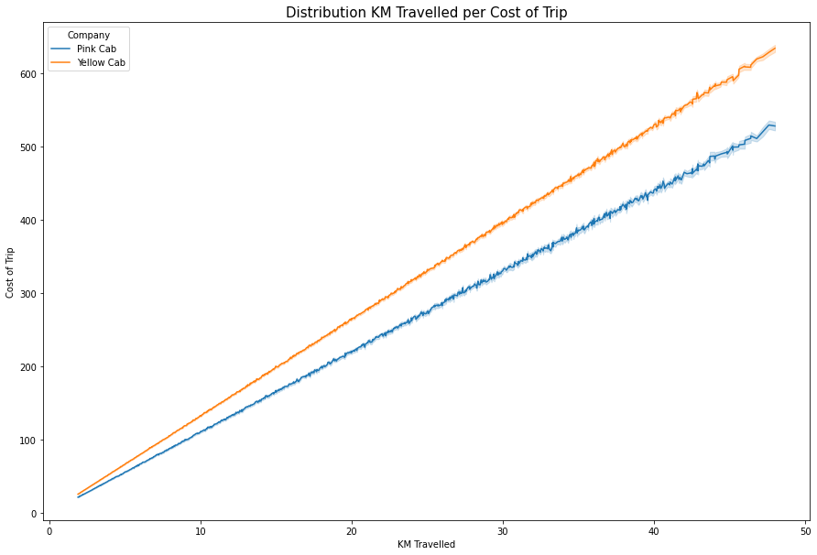
EDA - Distribution KM Travelled per Cost of Trip

Slide 17
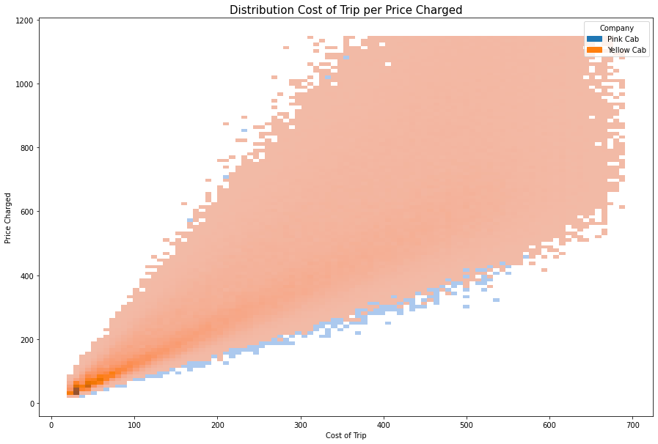
EDA - Distribution Cost of Trip per Price Charged
f
Th

Slide 18
EDA Summary
- After all these analyses and visualizations, we can answer the previous comparison questions
Compare Yellow Cabs and Pink Cabs from Different Aspects:
1. Compare Yellow Cabs and pink Cabs by performance
The Yellow Cab firm has higher performance than the Yellow Cab firm
2. Which Cab firm’s profit increased?
From Visualizations Profit Analysis, the Yellow Cab Firm is higher than Pink Cab Firm.
3. Which Cab firm is favored by customers?
From Visualizations User Analysis, and Yearly Users Analysis for each Cab firm, and Yearly Number of Gender for all Cab Firm the Yellow Cab Firm favorites from Customers Either Females or Males than Pink Cab Firm.
4. Which Cab firm in most cities?
From the transaction analysis visualization above, Yellow Cap Firm has high coverage in both large and small cities, with the most popular being (New York, New York, Boston, Massachusetts, Chicago, Illinois, and Los Angeles, California). Also, according to the city’s analysis, most users are yellow.
5. Which Cab firm has a bigger market share?
From all the above visualizations and the answers to the comparison questions, we understand that Yellow Cap Frim is bigger than Pink Cap Firm in Market Share.

Slide 19
Recommendations
Cab Firm performance:
From all Analyses and Visualizations, The Yellow Cab firm has higher performance than the Yellow Cab firm
Cab firm’s profit increased:
From Visualizations Profit Analysis, the Yellow Cab Firm is higher than Pink Cab Firm.
Cab firm is favored by customers:
From Visualizations User Analysis, and Yearly Users Analysis for each Cab firm, and Yearly Number of Gender for all Cab Firm the Yellow Cab Firm favorites from Customers Either Females or Males than Pink Cab Firm.
Cab firm in most cities:
From the transaction analysis visualization above, Yellow Cap Firm has high coverage in both large and small cities, with the most popular being (New York, New York, Boston, Massachusetts, Chicago, Illinois, and Los Angeles, California). Also, according to the city’s analysis, most users are yellow.
Does the cab firm have a bigger market share:
From all the above visualizations and the answers to the comparison questions, we understand that Yellow Cap Frim is bigger than Pink Cap Firm in Market Share.
Recommendations:
In a conclusion, the Yellow Cab firm has a bigger market share than Pink Cab Firm
So, We Recommend Yellow Cab Firm.

Slide 20
Username: alassirifatima@gmail.com LISUM14: 30Sep – 30 Dec 2022
Thank You

